Slide 1
Financial Accounting
IFRS 5th Edition
Weygandt ● Kimmel
Chapter 9
Plant Assets, Natural Resources, and Intangible Assets
This slide deck contains animations. Please disable animations if they cause issues with your device.
Copyright © John Wiley & Sons, Inc.

Slide 2
Learning Objective 4 Describe How to Account for Natural Resources and Intangible Assets.
L O 4
Notes:
Discussed tangible asset … useful for multiple periods; unlimited useful life: land (no depr); limited useful life … depreciate by allocating value .
Intangible asset: does not have physical substance

Slide 3
Intangible Assets
Rights, privileges, and competitive advantages that result from ownership of long-lived assets that do not possess physical substance.
Can have limited life or an indefinite life.
Common types of intangibles:
Patents | Trademarks
Copyrights | Trade names
Franchises and Licenses | Goodwill
L O 4
Notes:
Will discuss common types individually.

Slide 4
Accounting for Intangible Assets
Limited-Life Intangibles:
Amortize to expense
Credit asset account or accumulated amortization
Indefinite-Life Intangibles:
No amortization
However, they are tested yearly for impairment.
L O 4
Notes:
Intangible… we amortize … tangible is depr; (debit depr exp, credit acc dpr).
Intangible : credit asset account or accumulated amoritization.

Slide 5
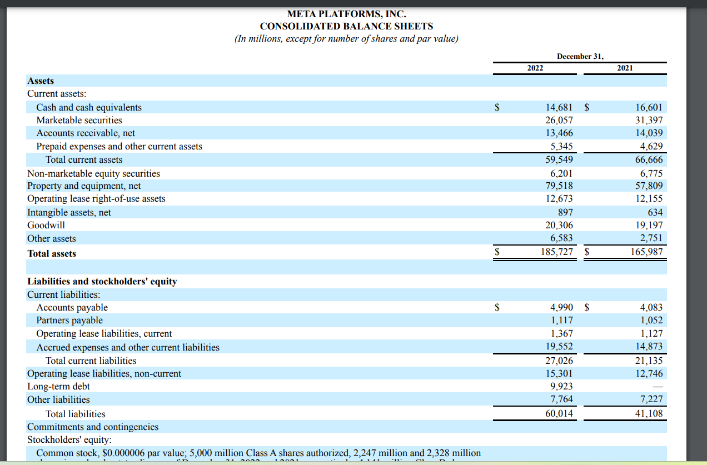
Meta’s intangible assets
Many companies will group intangible assets and goodwill together as one category in balance sheet.

Slide 6
Patents
Exclusive right to manufacture, sell, or otherwise control an invention for specified number of years from the date of grant
Legal life is 20 years in many countries
Capitalize cost of a patent and amortize it over its legal or its useful life, whichever is shorter
In general, we expense R&D costs in developing a patent
Legal fees incurred in successfully defending a patent are capitalized to Patents account
L O 4
Notes:
How can company get patent? They can buy (directly purchase), then easy to identify value. We capitalize cost of patent. Revenue expenditure … we directly record as expense; capex → record as asset first, then convert to expenses.
What if we develop patent by yourself? Develop through R&D … in this case, very difficult to measure exact cost of patent … R&D is a risky investment … difficult to estimate cost of patent if developed internally. We expense R&D if self-developed. Does not mean that internally developed patent is useless. We simply cannot estimate cost as it is difficult.
Legal fees → clearly can see that this went into cost of patent.

Slide 7
Accounting for Intangible Assets Example
Illustration: National Labs purchases a patent at a cost of NT$720,000. National estimates the useful life to be eight years. Prepare the journal entry to record the annual amortization for the year ended December 31.
Cost | NT$720,000
Useful life | ÷ 8
Amortization | NT$ 90,000
Dec. 31
Amortization Expense 90,000
Patents 90,000
L O 4
Notes:
If tangible → we have depr. If intangible, we have amortization.
Credit to patent (or accumulated amortization)

Slide 8
Copyrights
Give owner exclusive right to reproduce and sell an artistic or published work
Granted for life of creator plus a specified number of years (70 years in most countries)
Capitalize costs of acquiring and defending it
Amortized to expense over its useful life, which is generally shorter than its legal life
L O 4
Notes:
Copyright is expensive.

Slide 9
Trademarks and Trade Names
Word, phrase, jingle, or symbol that distinguishes or identifies a particular enterprise or product
Big Mac, Coca-Cola, and Jetta
Legal protection for specified number of years (often 20 years)
Registration may be renewed indefinitely as long as the trademark is in use
Capitalize acquisition costs
Indefinite life; no amortization
L O 4
Notes:
Trademark is internally develoed …

Slide 10
Franchises
Contractual arrangement between a franchisor and a franchisee
CPC, Subway, and Europcar are franchises
A right to sell certain products or services or to use certain trademarks or trade names within a designated geographic area.
Franchise (or license) with a limited life should be amortized to expense over its useful life
If life is indefinite, the cost is not amortized
L O 4

Slide 11
Goodwill
Includes exceptional management, desirable location, good customer relations, skilled employees, high-quality products, and harmonious relationship with labor unions
Can be identified only with the business as a whole
Only recorded when an entire business is purchased
Goodwill is recorded as the excess of purchase price over fair value of net assets acquired
Not amortized, but impairment test needed
L O 4
Notes:
Unlimited useful life … culture (part of goodwill) … only record good will if entire business is purchased…. In other cases, goodwill is hard to value.

Slide 12
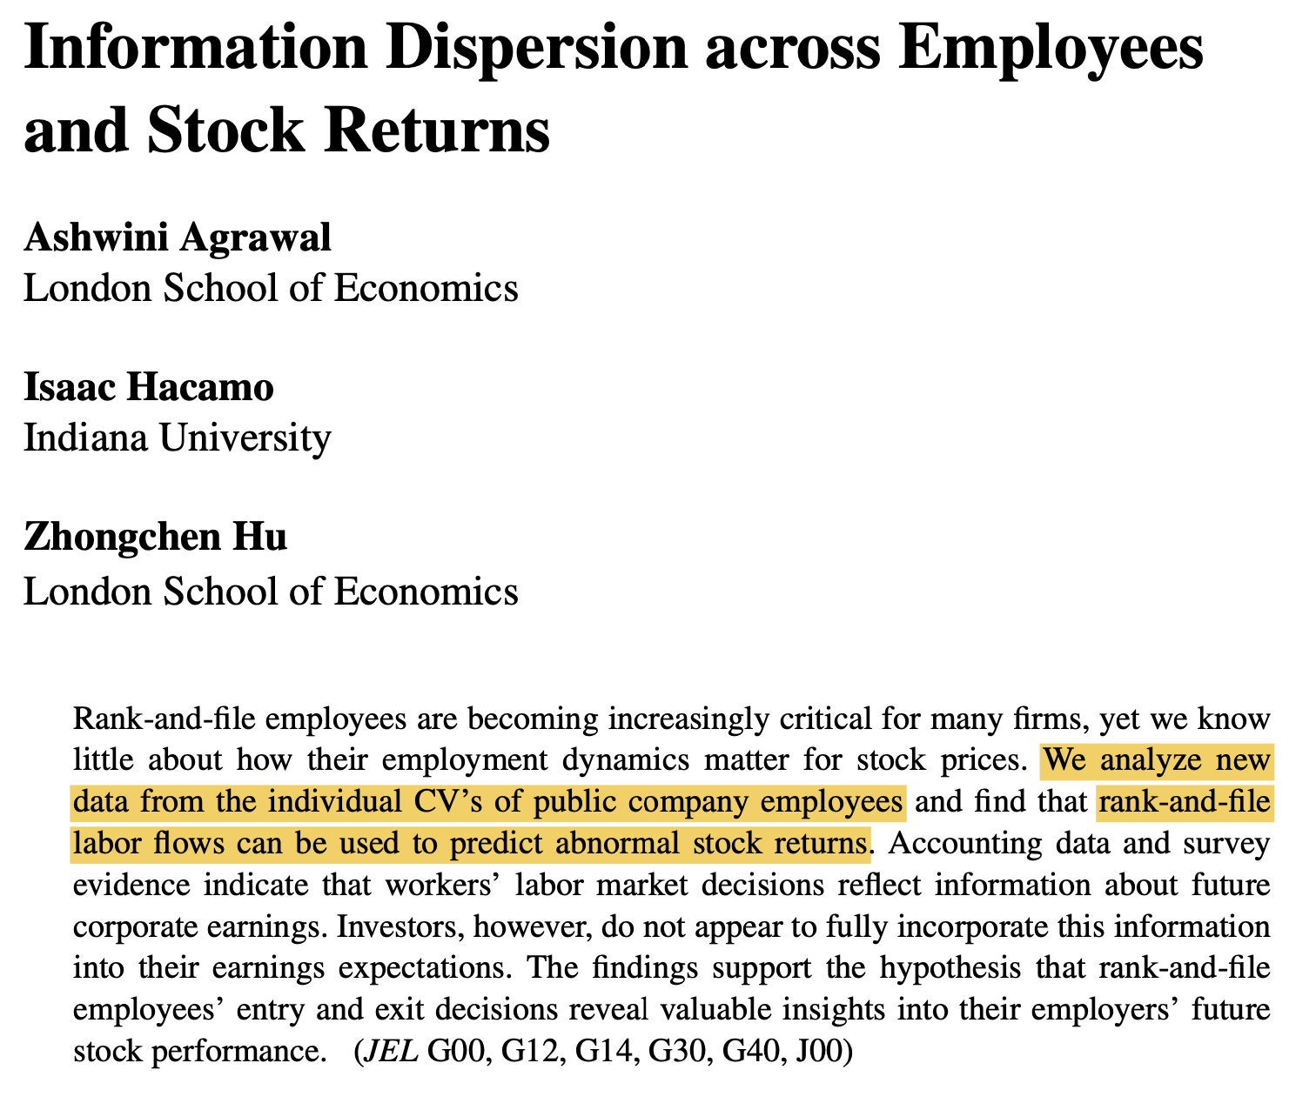
Notes:
Human Capital … very difficult to evaluate value of human capital

Slide 13
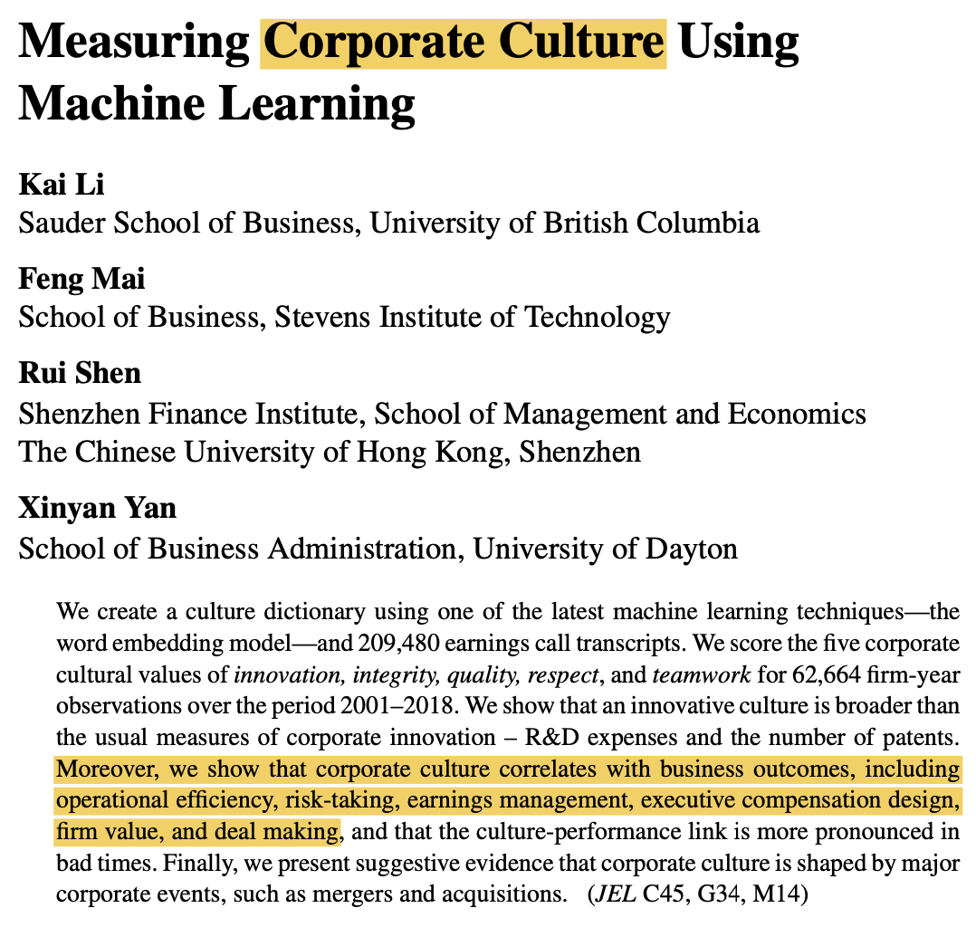
Notes:
Corporate culture

Slide 14
Research and Development Costs
Expenditures that may lead to
Patents, copyrights, new processes, new products
Costs in the research phase are expensed when incurred
Costs in the development phase are expensed until specific criteria are met, primarily that technological feasibility is achieved
Development costs incurred after technological feasibility is achieved are capitalized to Development Costs, an intangible asset
L O 4

Slide 15
LO4 Review Question
Which of the following statements is false?
If an intangible asset has a finite life, it should be amortized.
The amortization period of an intangible asset can exceed 20 years.
Goodwill is recorded only when a business is purchased.
Development costs are always expensed when incurred.
L O 4

Slide 16
LO4 – Solution
Which of the following statements is false?
If an intangible asset has a finite life, it should be amortized.
The amortization period of an intangible asset can exceed 20 years.
Goodwill is recorded only when a business is purchased.
Development costs are always expensed when incurred. (Correct)
L O 4

Slide 17
DO IT! 4: Classification Concepts
Match the statement with the term most directly associated with it.
Copyrights
Intangible assets | Franchises
Research costs
Rights, privileges, and competitive advantages that result from the ownership of long-lived assets that do not possess physical substance.
An exclusive right granted by a government to reproduce and sell an artistic or published work.
A right to sell certain products or services, or use certain trademarks or trade names within a designated geographic area.
Costs incurred by a company that often lead to patents or new products. These costs must be expensed as incurred.
L O 4

Slide 18
DO IT! 4: Classification Concepts – Solution 1 of 2
Rights, privileges, and competitive advantages that result from the ownership of long-lived assets that do not possess physical substance. Intangible assets
An exclusive right granted by the government to reproduce and sell an artistic or published work. Copyrights
A right to sell certain products or services or to use certain trademarks or trade names within a designated geographic area. Franchises
Costs incurred by a company that often lead to patents or new products. These costs must be expensed as incurred. Research costs
L O 4

Slide 19
Learning Objective 5 Discuss How Plant Assets, Natural Resources, and Intangible Assets are Reported and Analyzed.
L O 5

Slide 20
Presentation
Usually, companies combine plant assets and natural resources under “Property, plant, and equipment” in the statement of financial position
Intangible assets are shown separately
L O 5

Slide 21
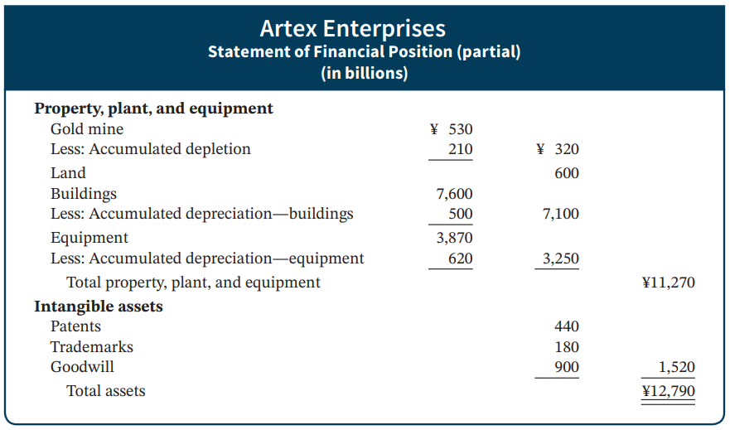
Statement Presentation
Illustration 9.23: Presentation of property, plant, and equipment, and intangible assets
L O 5

Slide 22
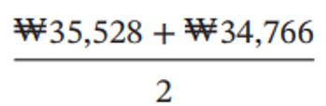
Analysis
Using ratios, we can analyze how efficiently a company uses its assets to generate sales. The asset turnover ratio analyzes the productivity of a company’s assets.
Illustration: LG’s net sales for a recent year were ₩58,140 billion. Its total ending assets were ₩35,528 billion, and beginning assets were ₩34,766 billion.
Net Sales | ÷ | Average Total Assets | = | Asset Turnover
₩58,140 | ÷ |  | = | 1.65 times
Illustration 9.24: Asset turnover formulas and computation
Each dollar invested in assets produced ₩1.65 in sales. If a company is using its assets efficiently, each investment in assets will create a high amount of sales.
L O 5
Notes:
Net sales --> sales revenue minus contra revenue (sales return & allownaces ; sales discounts)

Slide 23
DO IT! 5: Asset Turnover
Paramour Company reported net income of $180,000, net sales of $420,000, and had total assets of $460,000 on January 1, 2025, and total assets on December 31, 2025, of $540,000 billion. Determine Paramour’s asset turnover for 2025.
L O 5

Slide 24
DO IT! 5: Asset Turnover – Solution
The asset turnover for Paramour Company is computed as follows.
Net Sales | ÷ | Average Total Assets | = | Asset Turnover
$420,000 | ÷ |  | = | .84 times
L O 5

Slide 25
Financial Accounting
IFRS 5th Edition
Weygandt ● Kimmel
Chapter 10 and 11
Current Liabilities
This slide deck contains animations. Please disable animations if they cause issues with your device.
Copyright © John Wiley & Sons, Inc.

Slide 26
Chapter Outline
Learning Objectives
LO 1 Explain how to account for current liabilities.
LO 2 Explain how to account for non-current liabilities
LO 3 Discuss how liabilities are reported and analyzed.

Slide 27
Learning Objective 1 Explain How to Account for Current Liabilities.
L O 1

Slide 28
What is a Current Liability?
A debt that a company expects to pay within one year or the operating cycle, whichever is longer.
Current liabilities include notes payable, accounts payable, unearned revenues, and accrued liabilities such as taxes payable, salaries and wages payable, and interest payable.
To be classified as a current liability, a debt must be expected to be paid within one year or the operating cycle, whichever is longer.
L O 1

Slide 29
Notes Payable
Written promissory note due for payment within one year of statement.
Owe money to suppliers or banks and promise to pay in a certain day.
Usually requires borrower to pay interest. (where account payable does not bear interest)
Frequently issued to meet short-term financing needs.
Sometimes companies will call a note payable term loan, term debt, short-term borrowings, etc.
L O 1

Slide 30
Notes Payable Example
Illustration: First Hunan Bank agrees to lend ¥100,000 on September 1, 2025, if Yang Enterprises signs a ¥100,000, 12%, four-month note maturing on January 1 (amounts in thousands). When a company issues an interest-bearing note, the amount of assets it receives upon issuance of the note generally equals the note’s face value. Yang therefore will receive ¥100,000 cash and will make the following journal entry.
Sept. 1
Cash 100,000
Notes Payable 100,000
L O 1
Notes:
Face amount = amount borrowed on issue date. Do we have interest on issue date? No.

Slide 31
Notes Payable Example – Interest
Illustration: If Yang prepares financial statements annually, it makes an adjusting entry at December 31 to recognize interest expense and interest payable. The interest for the four months ended December 31, 2025:
Face Value of Note | × | Annual Interest Rate | × | Time in Terms of One Year | = | Interest
¥100,000 | × | 12% | × | 4/12 | = | ¥4,000
Illustration 10.1: Formula for computing interest
Yang makes an adjusting entry as follows:
Dec. 31
Interest Expense 4,000
Interest Payable 4,000
L O 1
Notes:
On 12/31, incur 4 months of interest. But no payment (since payment is on 1/1)

Slide 32
Notes Payable Example – Maturity
Illustration: At maturity (January 1, 2026), Yang must pay the face value of the note plus interest. It records payment of the note and accrued interest as follows.
Jan. 1
Notes Payable 100,000
Interest Payable 4,000
Cash 104,000
L O 1
Notes:
Debit to Int Pay, since we need to take it off our books.

Slide 33
Unearned Revenues
Revenues received before the company
delivers goods or
provides services
Account Title
Type of Business | Unearned Revenue | Revenue
Airline | Unearned Ticket Revenue | Ticket Revenue
Magazine publisher | Unearned Subscription Revenue | Subscription Revenue
Hotel | Unearned Rent Revenue | Rent Revenue
Illustration 10.2: Unearned revenue and revenue accounts
L O 1
Notes:
UnRev … get cash before they provide goods.

Slide 34
Unearned Revenues Example
Illustration: Liverpool F.C. (GBR) sells 10,000 season soccer (football) tickets at £50 each for its five-game home schedule. The entry for the sale of season tickets is:
Aug. 6
Cash (10,000 × £50) 500,000
Unearned Ticket Revenue 500,000
As each game is completed, Liverpool records the recognition of revenue with the following entry.
Sept. 7
Unearned Ticket Revenue 100,000
Ticket Revenue (£500,000 ÷ 5) 100,000
L O 1

Slide 35
Current Maturities of Long-Term Debt
Portion of long-term debt that comes due in current year
No adjusting entry required; at the statement of financial position date, all obligations due within one year are classified as current
Illustration: Wendy Construction issues a five-year, interest-bearing €25,000 note on January 1, 2025. This note specifies that each January 1, starting January 1, 2026, Wendy should pay €5,000 of the note. When the company prepares financial statements on December 31, 2025, it would report
Current liability | €5,000
Long-term liability | €20,000
L O 1
Notes:
Current liab: we will pay this year, so out of 25,000, we reclassify

Slide 36
Recognition of a Provision
Provision: potential liability that may become an actual liability in the future.
Companies accrue an expense and related liability for a provision only if the following three conditions are met:
A company has a present obligation as a result of a past event;
It is probable that an outflow of resources will be required to settle the obligation; and
A reliable estimate can be made of the amount of the obligation.
The term “probable” is defined as “more likely than not to occur”.
L O 2

Slide 37
Example: Product Warranty
Warranty: Promise made by a seller to a buyer to make good on a deficiency of quantity, quality, or performance in a product.
Estimated cost of honoring product warranty contracts should be recognized as an expense in the period in which the sale occurs.
L O 2

Slide 38
Reporting a Provision Example
Illustration: Assume that in 2025, Denson Manufacturing sells 10,000 washers and dryers at an average price of €600 each. The selling price includes a one-year warranty on parts. Denson expects that 500 units (5%) will be defective and that warranty repair costs will average €80 per unit. In 2025, the company honors warranty contracts on 300 units, at a total cost of €24,000. Denson records those repair costs incurred in 2025 to honor warranty contracts on 2025 sales as follows.
Warranty Expense 24,000
Repair Parts 24,000
L O 2

Slide 39
Provision Example – Estimating Liability
At December 31, to accrue the estimated warranty costs on the 2025 sales, less the amount already honored in 2025 of €24,000, Denson computes the warranty liability at December 31 as follows.
Number of units sold | 10,000
Estimated rate of defective units | × 5%
Total estimated defective units | 500
Average warranty repair cost | × €80
Estimated warranty liability | €40,000
Less: Warranty claims honored | 24,000
Warranty liability at December 31, 2025 | €16,000
Illustration 10.4 – Computation of estimated warranty liability
L O 2

Slide 40
Provision Example – Adjusting Entry
The company makes the following adjusting entry at December 31 for €16,000 after it adjusts for €24,000 of warranty claims honored during 2025.
Warranty Expense 16,000
Warranty Liability 16,000
The company reports:
warranty expense under selling expenses
warranty liability as a current liability, assuming it is estimated to be honored in the next year
L O 2

Slide 41
Provision Example – Subsequent Year
In the following year, assume that the company replaces 20 defective units in January 2026, at an average cost of €80 in parts and labor. The company would record expenses incurred in honoring warranty contracts on 2025 sales as follows:
Warranty Liability 1,600
Repair Parts 1,600
L O 2

Slide 42
Learning Objective 3 Discuss How Liabilities are Reported and Analyzed.
L O 2

Slide 43
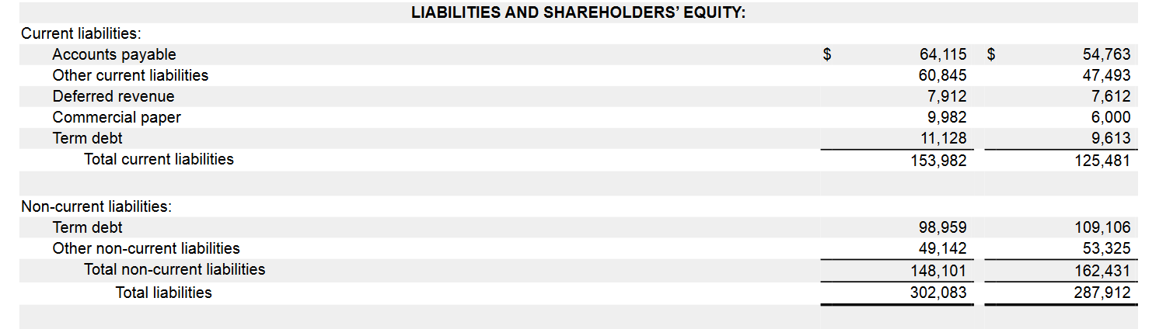
Apple’s liabilities
Apple borrows about $120 billion (commercial papers + current term debt + NC term debt)
Apple’s shareholder equity is only $50 billion

Slide 44
Why does Apple take on so much debt?
The cost of debt for Apple is lower than the cost of equity.
Borrowing reduces tax expenses for Apple (interest expense is tax free)
Most companies use a mix of equity and debt financing (i.e., capital structure). One of the CFO’s job is to maintain a healthy capital structure for the company.
To read: https://www.washingtonpost.com/business/2021/02/23/interest-rates-tax-code-help-apple/

Slide 45
Analysis of Current Liabilities
Liquidity refers to the ability to pay maturing obligations and meet unexpected needs for cash.
Current Assets | − | Current Liabilities | = | Working Capital
€20,856 | − | €16,210 | = | €4,646
Current ratio permits us to compare liquidity of different-sized companies and of a single company at different times.
Current Assets | ÷ | Current Liabilities | = | Current Ratio
€20,856 | ÷ | €16,210 | = | 1.29:1
Illustration 10.6-7: Working capital formula and computation (6) and Current ratio formula and computation (7)
L O 2
Notes:
WC = Current asset minus current liab… current asset: stuff you can convert to cash quickly. Current liab: stuff that you need to pay off in one year. Thus, WC represents how liquid your company is. If WC < 0, then you have less liquid assets than debt, meaning they cannot pay off debt within this year.
Current ratio lets you compare.

Slide 46
DO IT! 2: Reporting and Analyzing
Tron Cellular has the following account balances at December 31, 2025 (amounts in thousands).
Notes payable (NT$80,000 due after 12/31/26) | NT$200,000
Unearned service revenue | 75,000
Other long-term debt (NT$30,000 due in 2026) | 150,000
Salaries and wages payable | 22,000
Other accrued expenses | 15,000
Accounts payable | 100,000
In addition, Tron is involved in a lawsuit. Legal counsel feels it is probable Tron will pay damages of NT$38,000 in 2026.
Prepare the current liabilities section of Tron’s December 31, 2025, statement of financial position.
Tron’s current assets are NT$504,000. Compute Tron’s working capital and current ratio.
L O 2
Notes:
Probable to pay .. .therefore you need to recognize this as well.

Slide 47
DO IT! 2: Reporting and Analyzing – Solution
Current liabilities
Notes payable (NT$200,000 − NT$80,000) | NT$120,000
Accounts payable | 100,000
Unearned service revenue | 75,000
Lawsuit liability | 38,000
Salaries and waged payable | 22,000
Other accrued expenses | 15,000
Long-term debt due within one year | 30,000
Total current liabilities | NT$400,000
Working capital = Current assets − Current liabilities = NT$504,000 − NT$400,000 = NT$104,000
Current ratio = Current assets ÷ Current liabilities = NT$504,000 ÷ NT$400,000 = 1.26:1
L O 2

